Slide 1
Detecting Malicious Blockchain Activity
Presenters: Ori Sinvani, Nehoray Chalfon, Harel Brener Project Advisor: Ofer Zevin Data science Project

Slide 2
Background
Crypto
Problem
Solution
Blockchain technology caused a financial revolution
Instant transfer
Unregulated
Anonymous
Today the technology is used in part for:
Money laundering
Terror funding
Tax evasion
There is a need for automatic tools to track these behaviours
Notes:
הבלוקצ'יין הוא ספר חשבונות דיגיטלי מבוזר שמתעד עסקאות על פני רשת מחשבים, בצורה שקופה ושאינה ניתנת לשינוי. במקום להסתמך על גורם מרכזי כמו בנק, הרשת כולה מאמתת ומאבטחת כל עסקה.

Slide 3
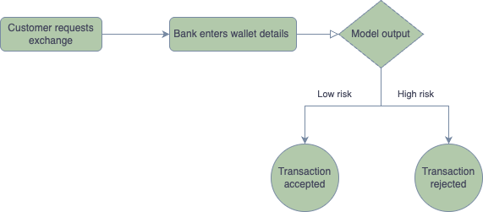
Our Clients
Our product is made for:
Financial institutions
Military and police
Businesses and individuals

Slide 4
Goals & Challenges

Slide 5

Goals
Build a system that:
Interaction with user
Processes real-time transaction data
Classification of requested wallet
Results Showcase to user

Slide 6
System Architecture

Slide 7
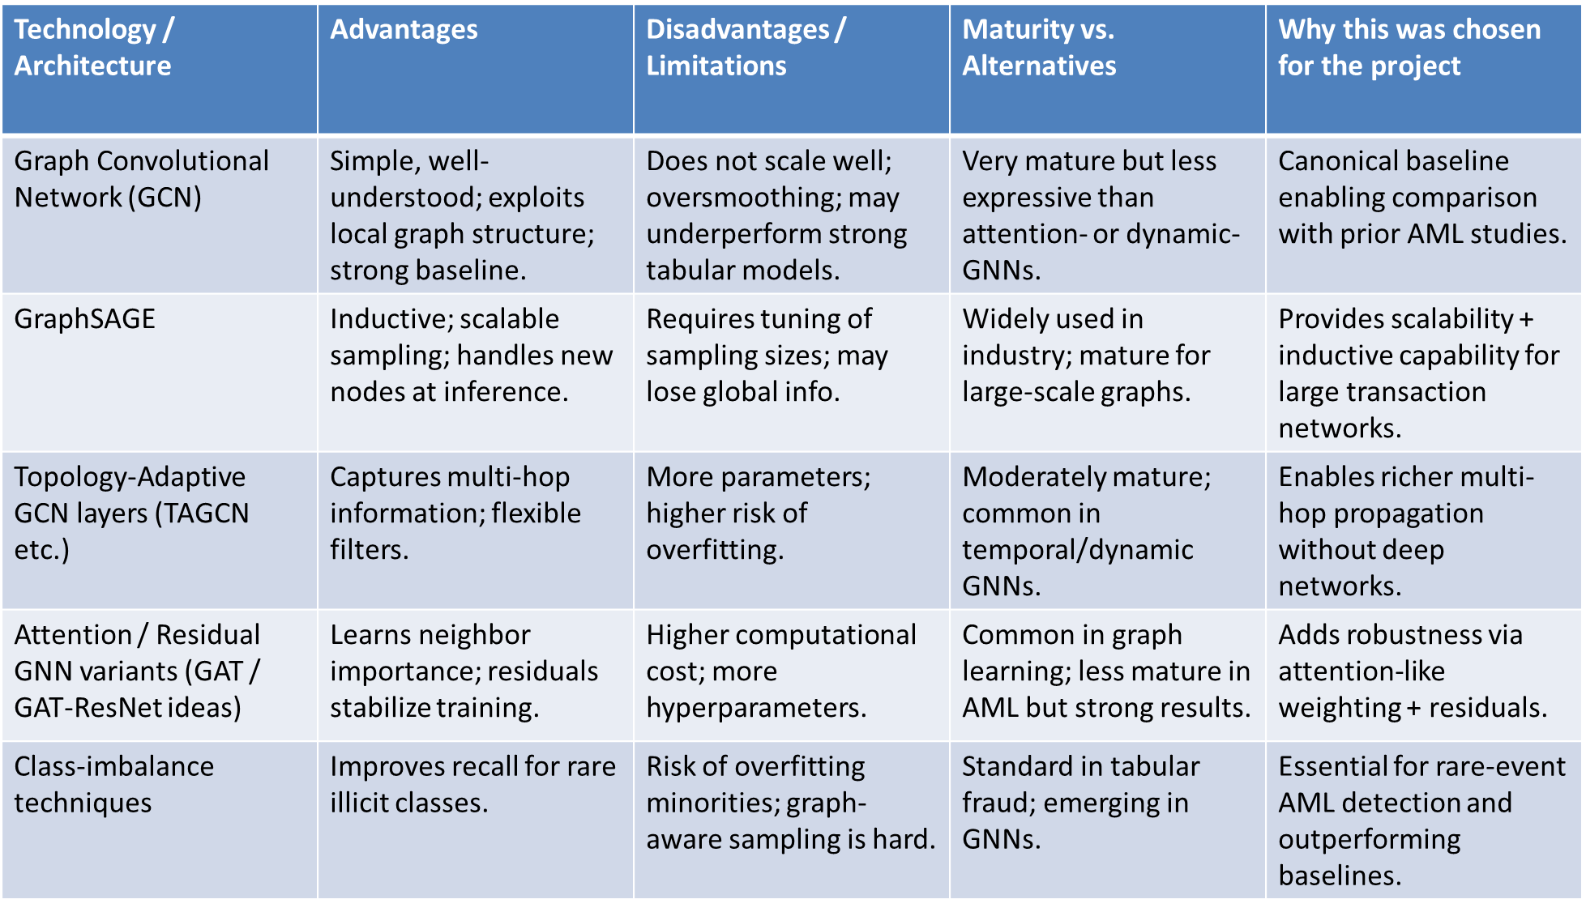
Technologia

Slide 8
Literature Review

Slide 9
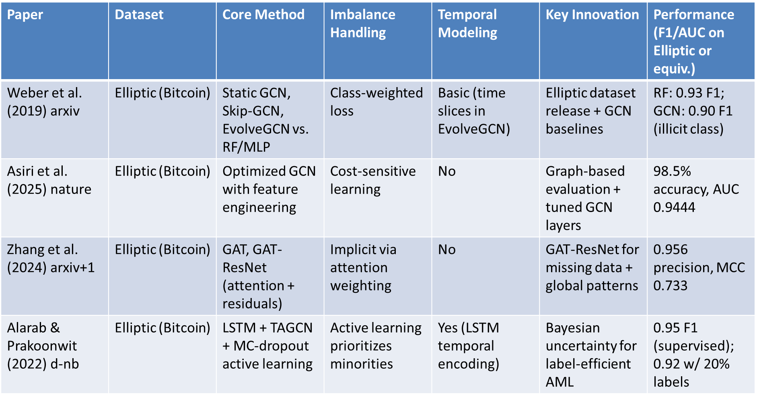

Slide 10
Exploratory Data Analysis

Slide 11

Data
Elliptic
Bitcoin, 203K labeled transactions
Anonymized features
Real-CATS
Over 200K labeled wallets
Bitcoin & Ethereum
25 Features

Slide 12
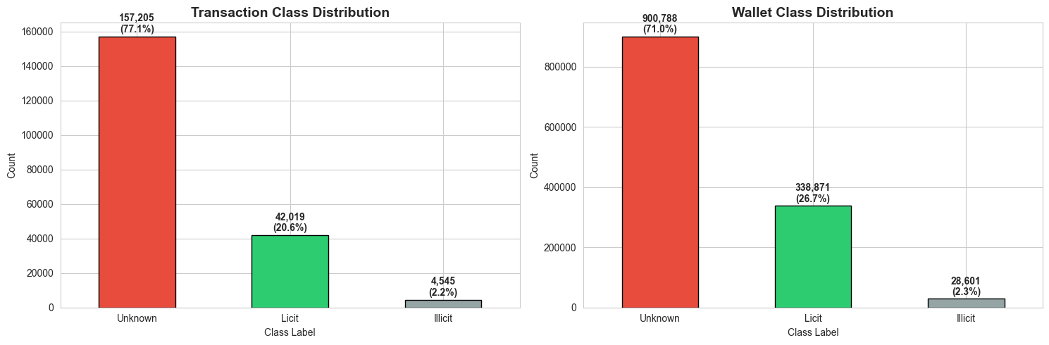

Elliptic ++ - EDA
Dataset Shapes:
Transactions: (203769, 186)
Wallets: (1268260, 59)
Transaction edges: (234355, 2)

Slide 13
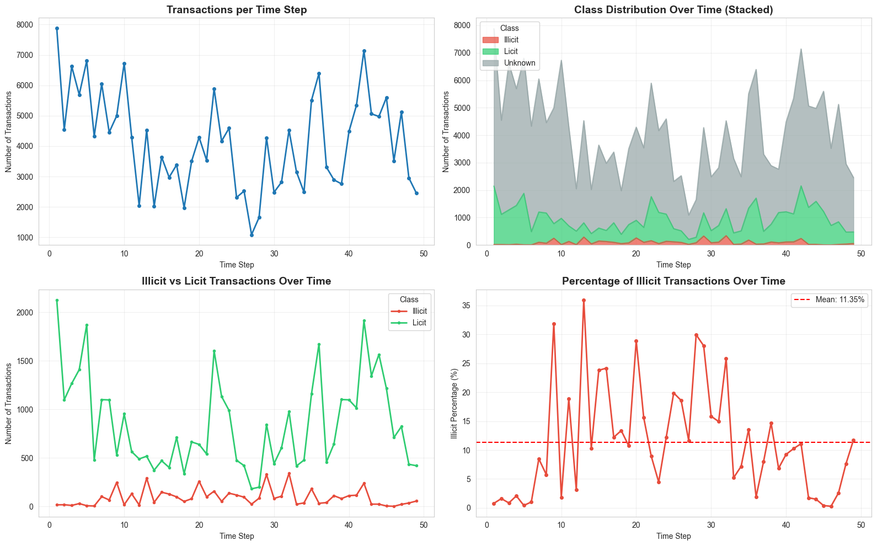
Transactions over time

Slide 14
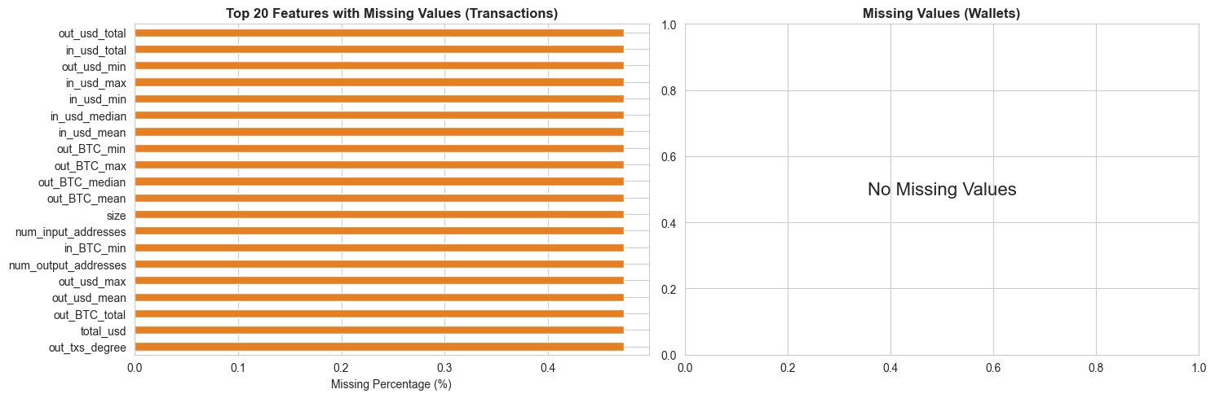
Missing values

Slide 15
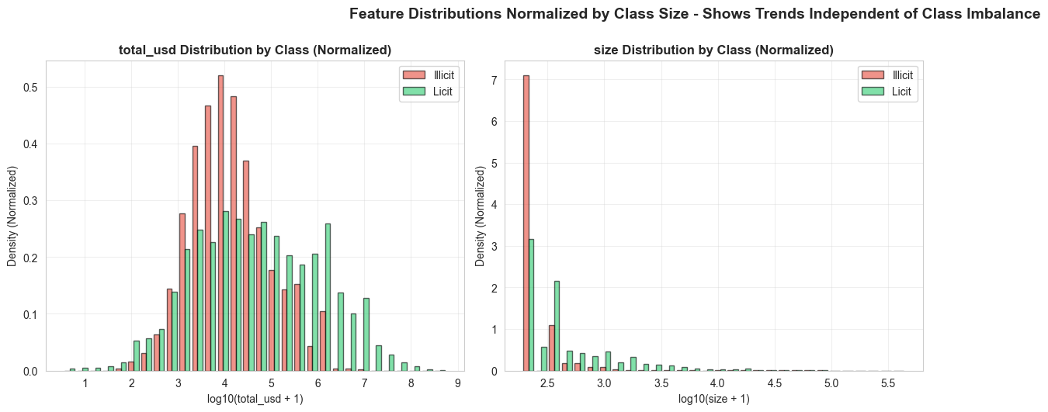
Licit vs Illicit

Slide 16
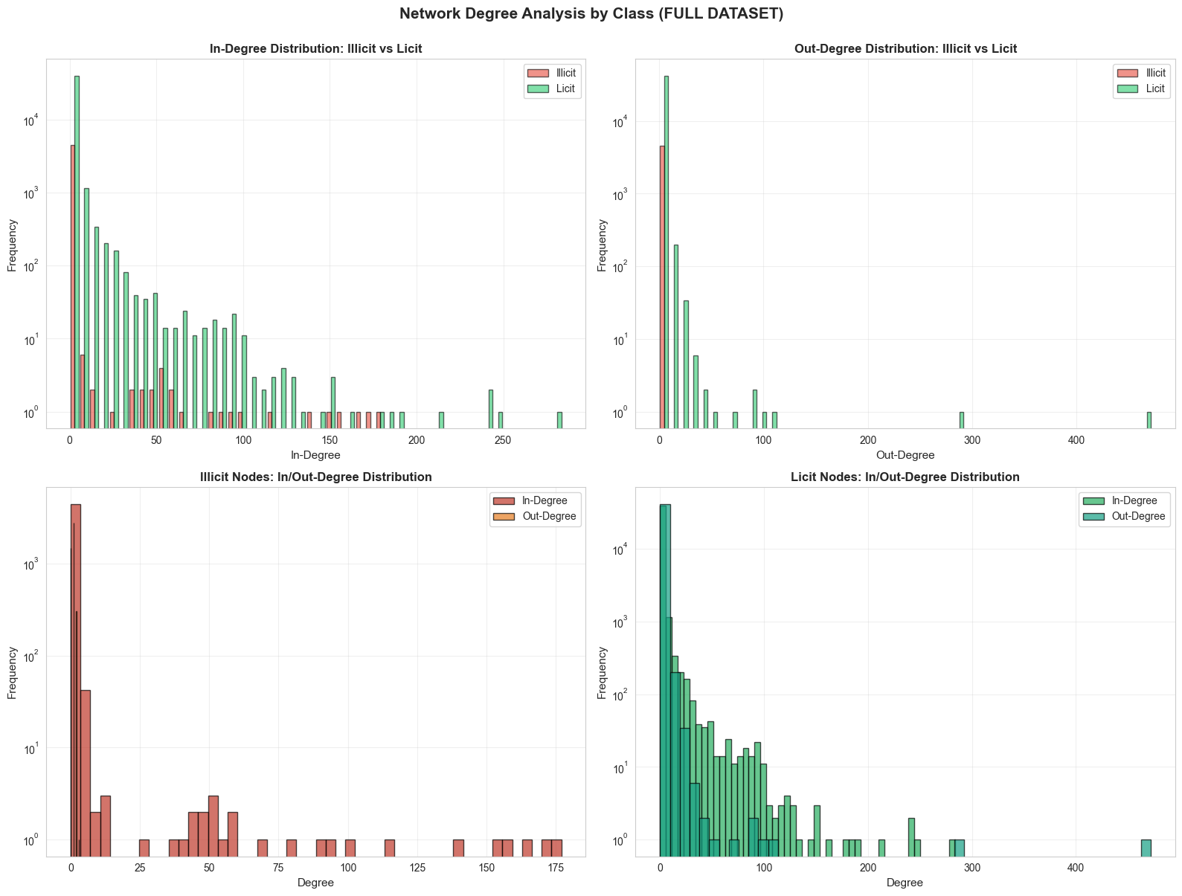
Licit vs Illicit

Slide 17
Class Distribution In Network
From | To | Count
Unknown | Unknown | 131,778
Unknown | Licit | 45,386
Licit | Licit | 33,930
Licit | Unknown | 15,116
Unknown | Illicit | 3,993
Illicit | Unknown | 1,458
Illicit | Illicit | 998
Illicit | Licit | 915
Licit | Illicit | 781

Slide 18
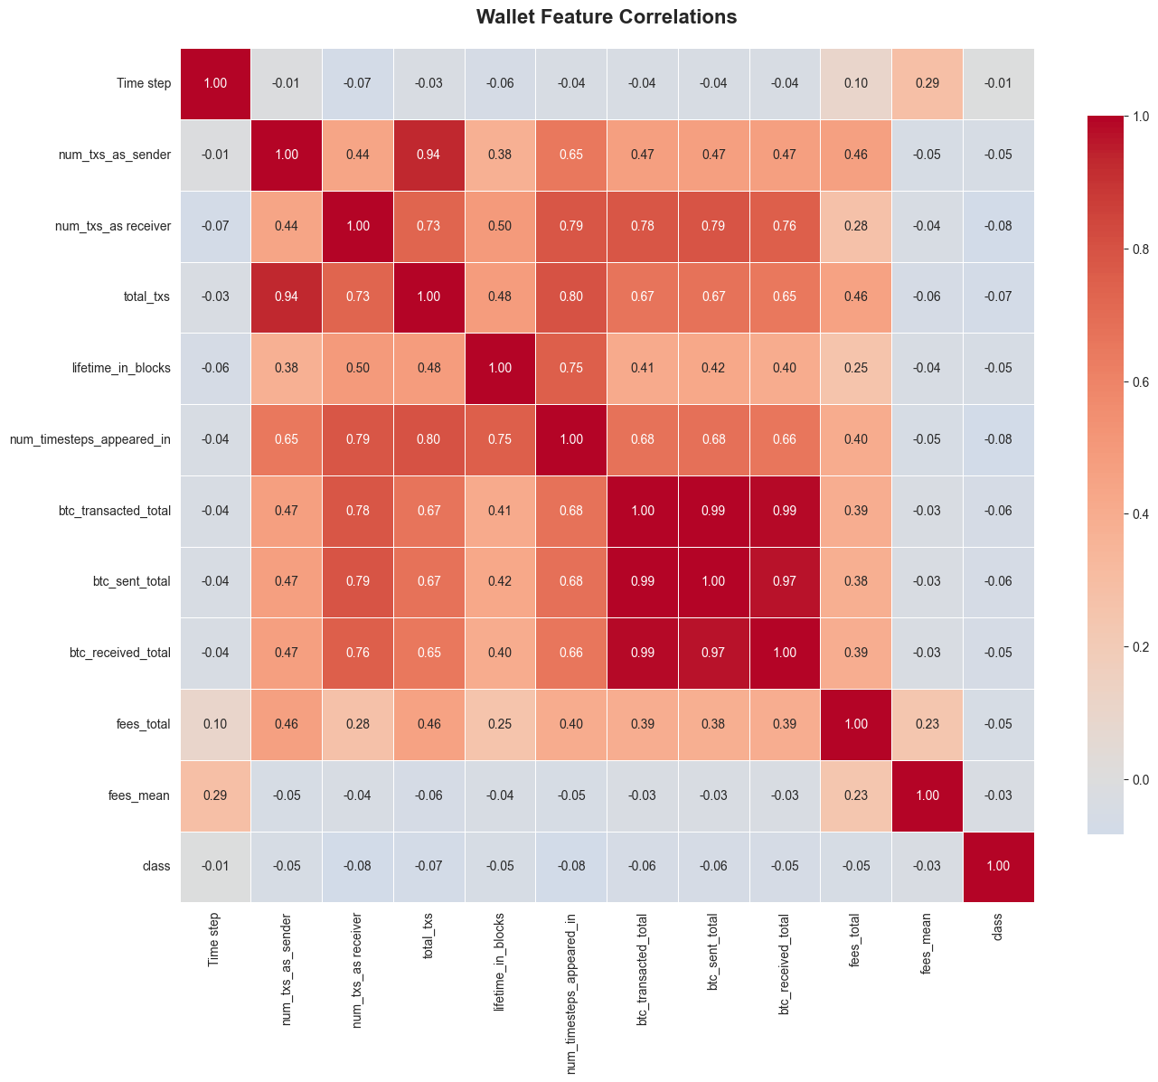
Elliptic ++ - EDA - Wallet Feature Correlation

Slide 19
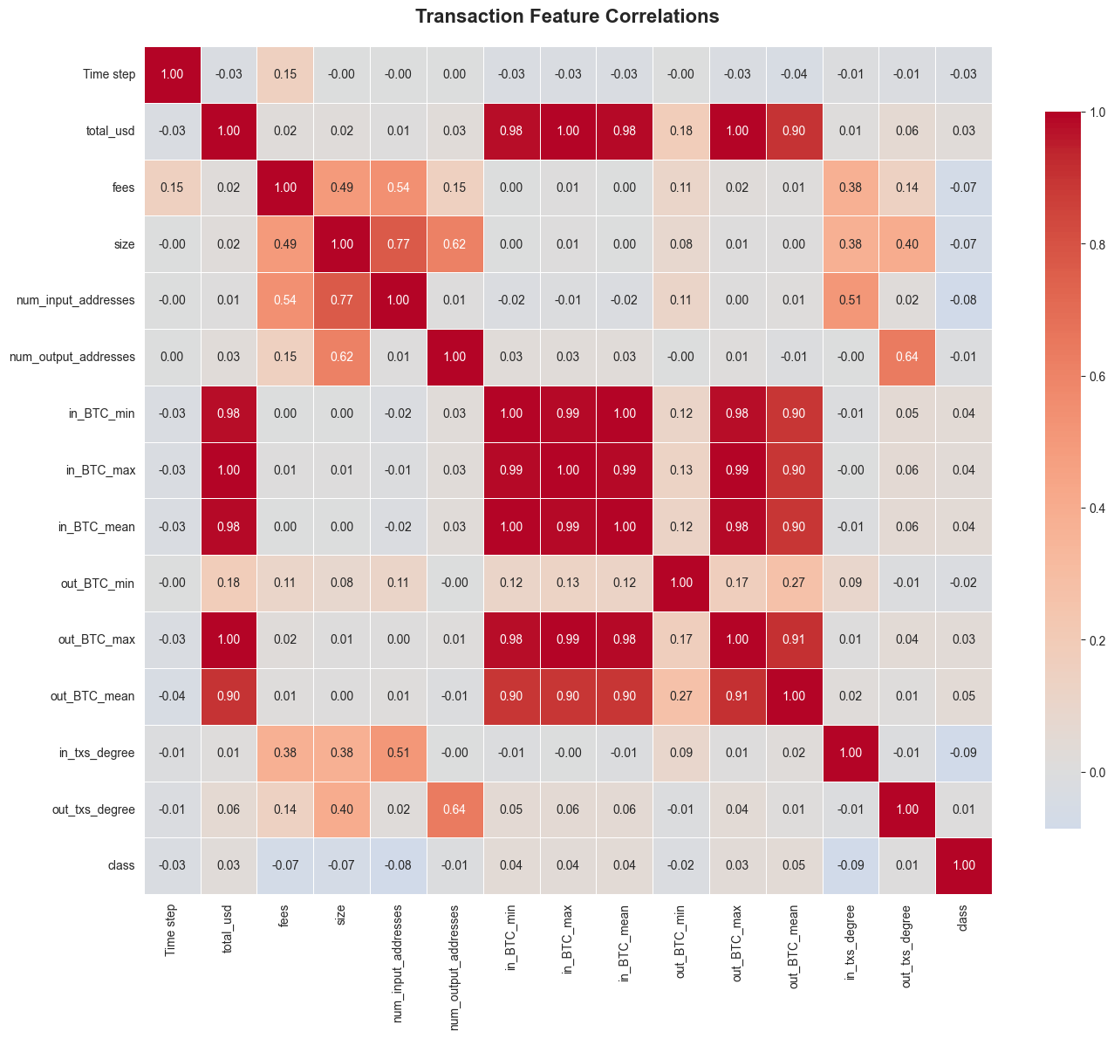
Elliptic ++ - EDA - Transaction Feature Correlation

Slide 20
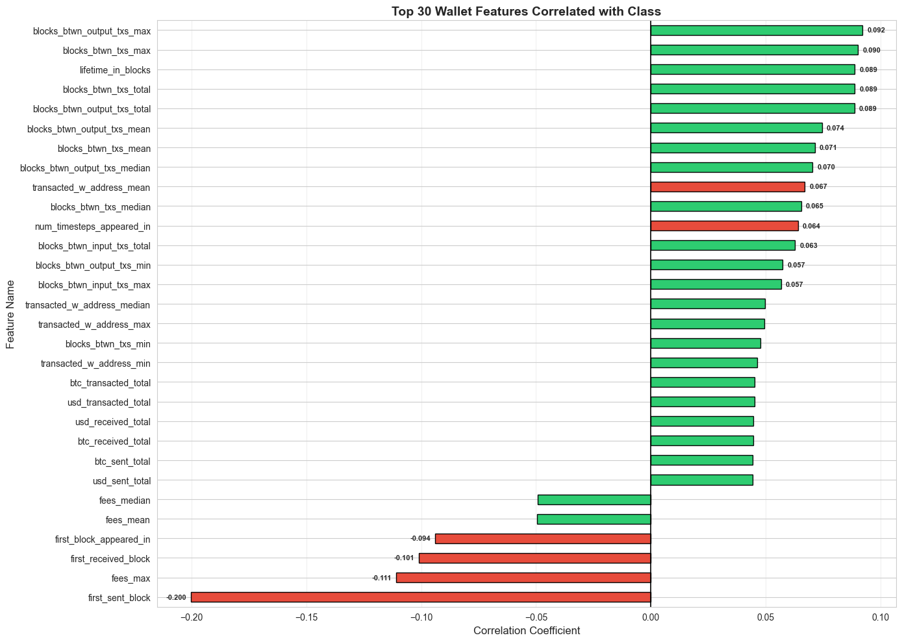
Elliptic ++ - EDA - Feature Correlation To Class

Slide 21
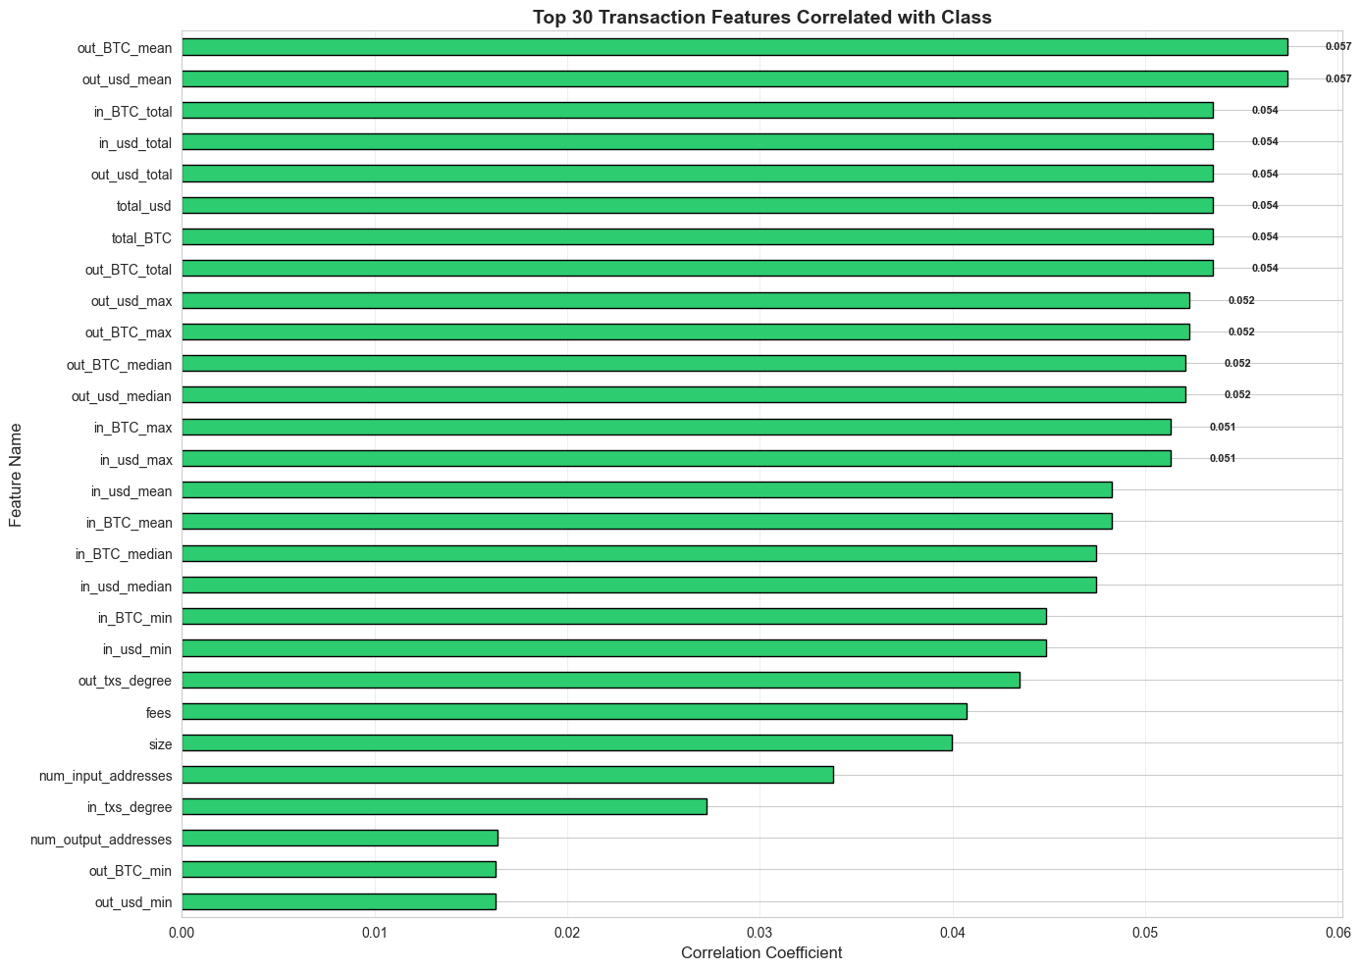
Elliptic ++ - EDA - Feature Correlation To Class

Slide 22
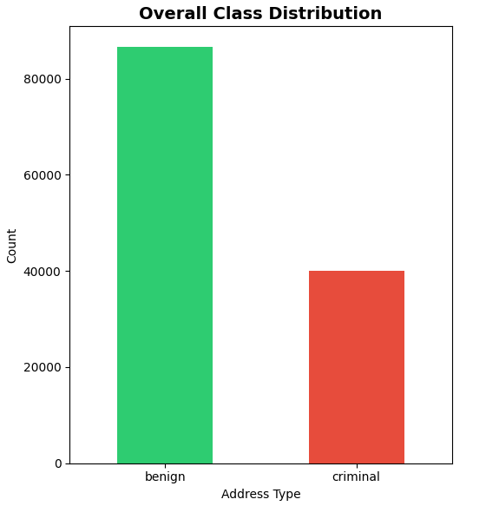
REAL-CATS EDA
Data composition:
Total addresses: 126,615 Bitcoin addresses
Criminal Addresses: 40,032 (31.6%)
Benign Addresses: 86,583 (68.4%)
Class Balance: 1:2.16 ratio
Filtering: Removed zero-transaction addresses
Data quality:
Complete Features: 26 out of 37 features
High Missing (>10%): 10 features (mostly transaction detail fields)

Slide 23
Transaction Patterns
Metric | Criminal Median | Benign Median | Difference | Significance
Transaction Count | 4.0 | 2.0 | 2.0x higher | Criminals are more active
Total Received (USD) | $2,433 | $1,591 | 53% higher | Criminals have Higher volumes
Total Sent (USD) | $2,426 | $1,049 | 131% higher | Criminals send much more money

Slide 24
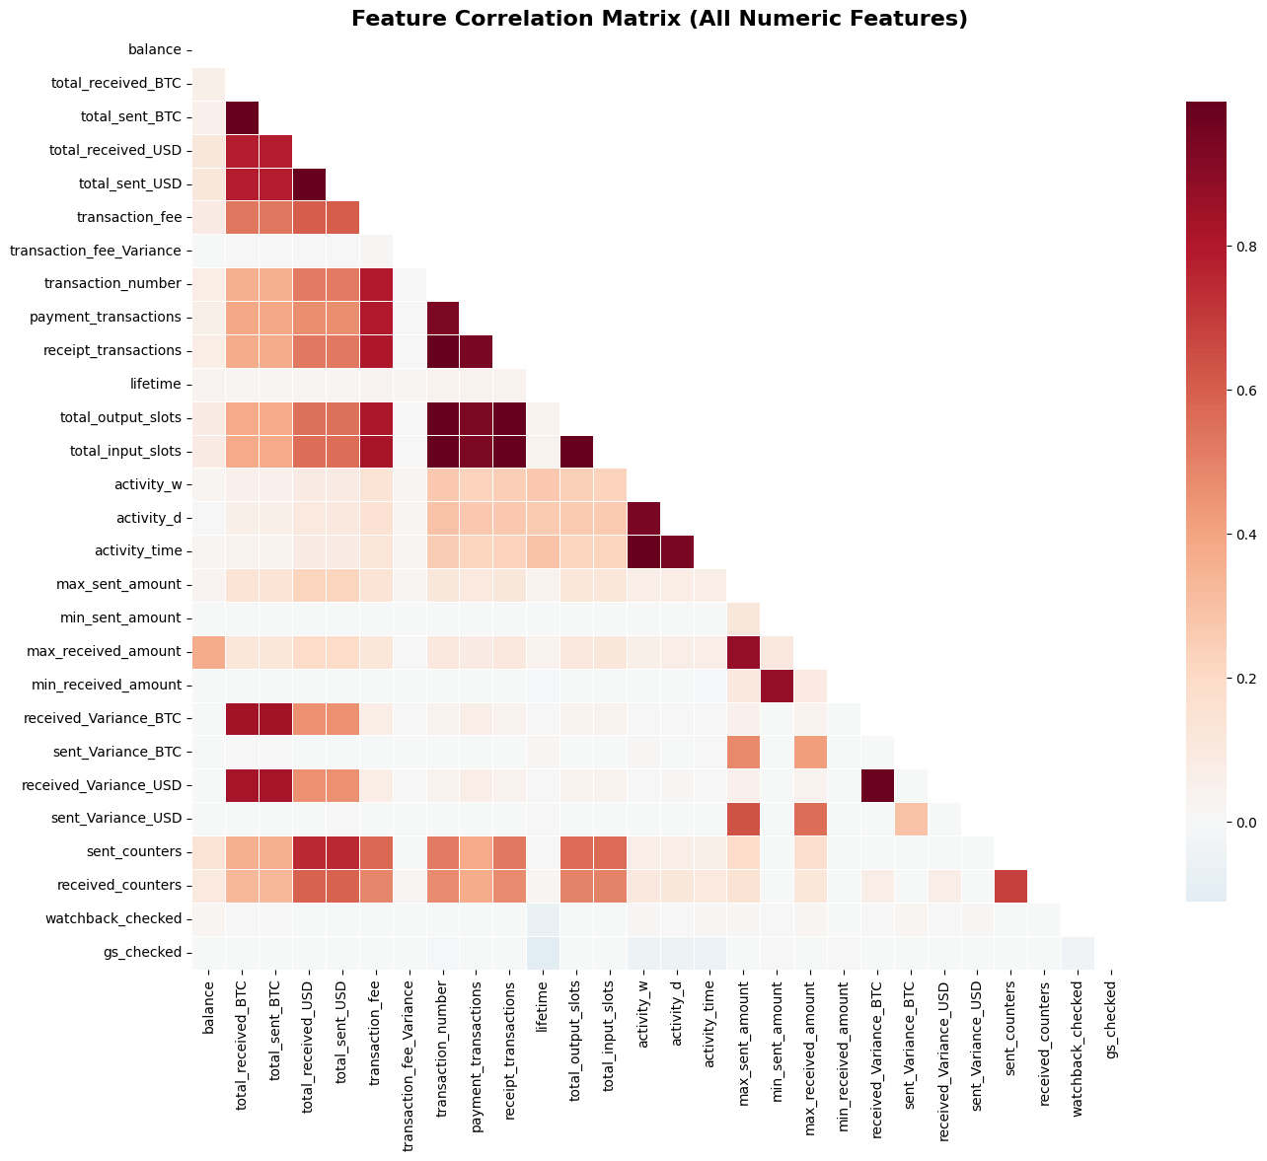
Feature Correlation
Top Problematic Correlations
1. totalreceivedBTC ↔ totalsentBTC: 1.000
2. totalreceivedUSD ↔ totalsentUSD: 1.000
3. totaloutputslots ↔ totalinputslots: 0.999
4. transactionnumber ↔ receipttransactions: 0.995
5. activityw ↔ activitytime: 0.995

Slide 25
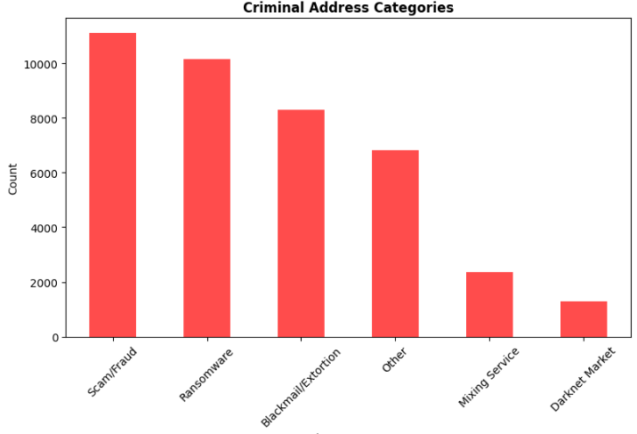
Criminal Address Analysis
Prevalence vs. Perception
Simple scams and ransomware remain the dominant forms of Bitcoin criminal activity.
Volume: These "low-tech" crimes represent the vast majority of illicit volume.
Specialization: Mixing services represent a much smaller, highly specialized segment of the criminal ecosystem.

Slide 26
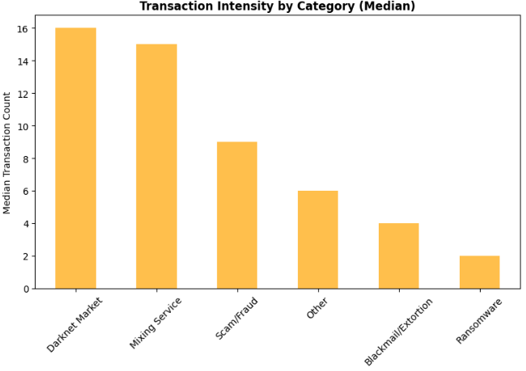
Criminal Address Analysis
The Metric:
Transaction frequency proxies for organizational sophistication.
Structured:
High frequency; requires continuous liquidity.
Opportunistic:
Low frequency; relies on disposable wallets.

